Slide 1

Zowe Joint Community 21PI1 (Q1) Context & Vision
Presenters: Michael DuBois, Bruce Armstrong, Peter Fandel
Now TSC: Mark Ackert, Joe Winchester, Sean Grady
Notes:
Speaker -

Slide 2
Agenda
Quick overview of key community metrics from December
Zowe deliverables and achievements from last PI
Awareness of proposed ZLC and TSC Positioning
ZLC comments on Squads High Level Plans

Slide 3
Community Highlights

Slide 4
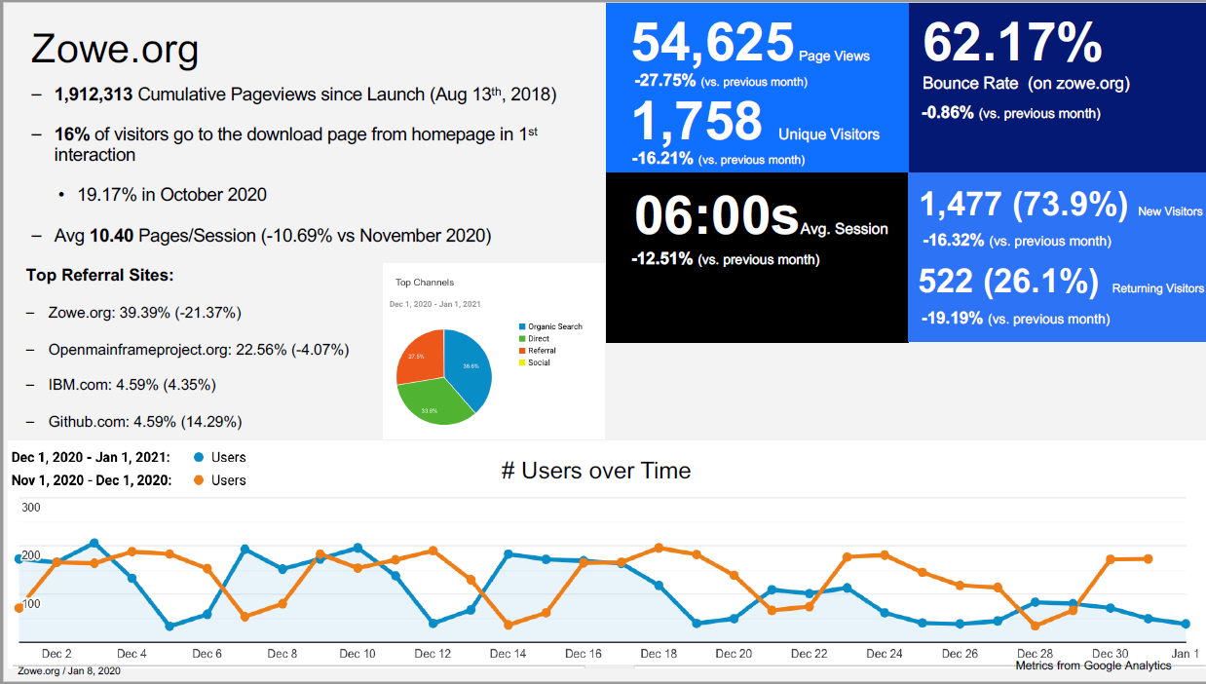
Still attracting new visitors

Slide 5
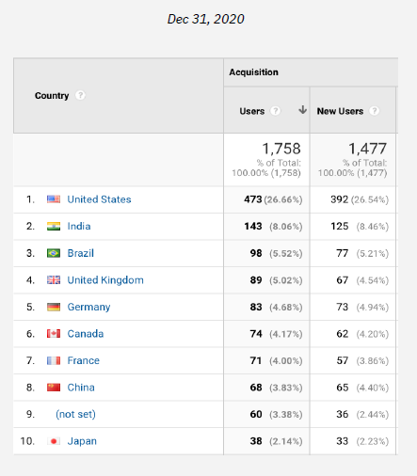
Still Worldwide Interest
US
India
Brazil
UK
Germany
Canada
France
China
Japan

Slide 6
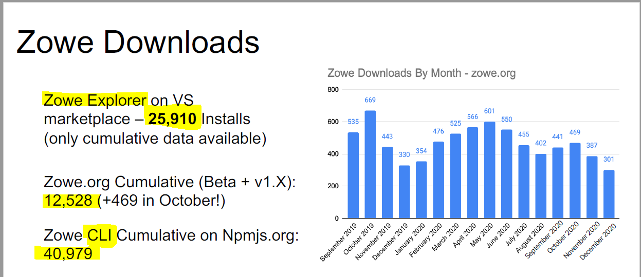

27,073 as of Jan 24

Slide 7
Quick recap of 2020
March: The 1.9 release of Zowe Long Term (LTS) Support released
April: Zowe makes its debut in the Open Mainframe Project COBOL Training Course which takes advantage of the Visual Studio Code (Zowe Explorer) extension
April: Zowe welcomes 2 new components to the Zowe ecosystem – Zowe Client SDKs and Zowe Mobile as incubation projects.
June: The Zowe Conformance Program introduces V1 Conformance Requirements and Badges to align with the LTS release.
February through July: Releases 1.9 to 1.13 include major advances in security authentication and authorization options through the introduction of Single Sign-On (SSO) and JWT Token Multifactor Authentication (MFA) capabilities. As well as supporting TLS certificates held in USS keystores, Zowe added support for certificates held in z/OS keyrings.
August 2020: A new commercial product offering dependent on Zowe technology from a vendor beyond the initial Zowe contributors. Software Engineering Db2 SQL Workload Expert for Db2 z/OS
August - October: Hundreds of attendees participated in several Zowe Educational Sessions •SHARE Virtual Event • Open Mainframe Summit• The Oct 2020 Zowe Quarterly Update •Open Mainframe Mini Summit at OSS EU…. Master the Mainframe with Zowe Explorer and Zowe CLI
December 2020: The Zowe Community formally established a new TSC (Technical Steering Committee)

Slide 8
What did we deliver last PI?
Notes:
Speaker

Slide 9

20PI4 Zowe Achievements
Zowe CI/CD Squad
Improved Zowe packaging manifest and corollary conversion of launchers
Zowe performance testing on Marist, and early performance dashboard
New Zowe component-based installer
Created intent-based and component-based information roadmaps for better onboarding (not published yet)
Supported content delivery for Zowe releases (Docker, manifest, etc.)
Added Zowe Explorer to zowe.org for better visibility
Zowe Website Navigation Recommendations:
Persona interviews and research
Navigation improvements
Revised Zowe introduction presentation
Semi-Annual Zowe Survey
Zowe Quarterly Webinar
10 new blogs (7 core, 3 ecosys) on Medium.com/Zowe
Facilitated feedback between the Zowe Explorer and Master the Mainframe teams, following the MTM 2020 course being built around Zowe Explorer
Worked with squad SMEs to help customers troubleshoot Zowe installation and configuration problems live 1:1 via WebEx.
Zowe CLI Squad
Zowe API Squad
Improved Zowe CLI onboarding experience by making configuration information easier to share and easier to store within projects (available for technical validation)
Improved the response time of Zowe CLI (available for technical validation)
Validated Zowe CLI against a new major LTS release of Node (Node v14) (Zowe v1 LTS).
Improved experience for installing and using Zowe CLI over a proxy (pending availability in 1.20)
Docker technical preview available for Zowe servers on Linux & zLinux
Desktop editor enhanced to fill feature gaps from USS explorer; desktop editor now preferred USS editor
Desktop editor prototype for locking & writing datasets, to be finalized next PI
End user request: "Single app mode" redesigned for framework feature parity with desktop. Notifications, app2app communication now possible in this mode.
New app introduced by new Broadcom contributors to squad, IP Explorer App. We hope to get this into users hands during next PI
Collaborated with system squad to define packaging improvements. Initial package management goal not achieved, but improvements are beneficial to goal.
Client certificate validation using ESM to map the certificate with the user mainframe identity (technical preview in 1.19)
Standalone configuration of API Mediation Layer (1.18)
Multiple API version support in the API Catalog (1.17)
Launch and restart API ML components individually (1.18)
Caching service using VSAM for persistence to share state data across components (technical preview)
Feature: Allocate-like for creating new datasets.
Feature: zFTP API support for USS in the zFTP extension (a.k.a. FTP Extension for Zowe Explorer)
Feature: Filtering of PDS members based on pattern (e.g. "HLQ.DATASET(MEMBER*)" )
Feature: Editable Dataset Attributes on allocation
Feature: Allocate multiple datasets from a JSON file
Research: Consistent Refresh behavior throughout Zowe Explorer
Research: Perform actions on multiple datasets (e.g. bulk deletion)
Fixes: UX related fixes to Profile Management throughout Zowe Explorer
Zowe Documentation Squad
Zowe App Framework Squad
Zowe Explorer Squad
Zowe Onboarding Squad
Notes:
Speaker – Mike DuBois
20PI3 CLI Squad Achievements
Zowe Client Python SDK published.
Has been published to Python Package Index
Check out the documentation: https://zowe-client-python-sdk.readthedocs.io/en/latest/packages/packages.html
Zowe Client Swift SDK is available in GitHub
-> https://github.com/zowe/zowe-client-swift-sdk.
Let us know your feedback! We will plan to publish some documentation around this in the next PI if there is interest.
Node SDK is nearly published.
Will be published to public npm
The corresponding SDK doc will be published and content will be added to Zowe.org once the Node SDK is live.
20PI3 API Squad Achievements
The API Squad closed over 140 Issues and PRs notably...
Removed the dependency of Zowe API ML on z/OSMF for authentication by adding SAF as an additional authentication provider (for obtaining the JWT) #472
The Swagger URL is now provided for z/OSMF. This URL provides full documentation containing the Try It Out functionality if the z/OSMF version supports the Swagger endpoint. Alternatively, the URL provides the info endpoint to directly enable access to Zowe endpoints. #665
The default configuration of API ML now supports character encoding. #777
Welcomed 2 new members - Jordan Cain & Carson Cook
20PI3 App Framework Squad Achievements
Revised and detailed HA/FT plan with other squads, significantly reducing the complexity of implementation and improving the expected user experience and HA/FT guarantees
Eliminated the need to implement a leader electrion algorithm in ZSS
Investigated potential state storage DBs for a good match; compiled redis on z/os to evaluate
Created an automated build pipeline for and posted to dockerhub a Dockerized release of Zowe's server runtimes as an option to run under Linux as an alternative to z/OS
Drafted documentation on how to use the docker image
Ran and concluded a mentorship program with the OMP for 4 mentees to enhance the app framework and kickstart new app development
20PI3 Zowe Explorer Squad
Enhanced user experience by introducing a configurable/toggleable profile validation mechanism. (v1.7.0, v1.9.0)
Improved installation speed and overall performance by bundling the extension using Webpack. (v1.8.0)
Augmented developer experience by implementing the `Allocate-Like` functionality to simplify the creation of datasets (v1.9.0)
Elevated user experience by grouping favorites into a more consistent profile-specific view (v1.9.0)
Tech Debt: Finalized unit and integration tests refactoring (Carry-over v1.7.0)
20PI3 Documentation Squad Achievements
Overall
API reference guide available (Thanks @Carson)
Release notes process streamlined with automation (This is a highlight, it helps every squad to deliver more efficiently)
Supported each Zowe 1.x.x release, curated contributions to documentation, and supported the community.
Zowe CLI
Created documentation for the Zowe Client SDKs. Download the SDKs from Zowe.org. (Note: doc isn't published yet, pending code delivery)
Documented how to leverage the SSO/MFA features in Zowe CLI, using the new "base profile" to store a token.
20PI3 Onboarding Squad Achievements
On-boarded a new ISV: Software Engineering (i.e. SEGUS Software) to Zowe
Introduced the V1 Conformance Program including
New Badges
Revised Terms & Conditions
Revised Test Criteria, Test Criteria Format and Test Criteria “storage” i.e. moved to GitHub
Introduced the Test Criteria Change Process
Transitioned the Metrics Gathering to new members, began researching automation, introduced “live pull” from Google sheets
Social Media Management of Medium.com/ZOWE
Categorized 54 blogs {CORE} or {Ecosystem}
Reviewed and introduced 9 new blogs in 19PI3
Established Zowe Quarterly Webinar series
Showcased: 11: API ML Conformant Extensions / 5: App Framework Conformant Extensions / 25: Conformant CLI Plug-ins

Slide 10
ZLC and TSC Positioning

Slide 11
Proposed New “ZLC” Charter
“Zowe Advocate Council”?
Proposed reword of https://github.com/zowe/zlc
The Zowe Leadership Committee (ZLC) oversees all code development and release management for the Zowe project.
The ZLC is to provide input to the TSC on vendor and consumer considerations for the adoption of Zowe technology. The ZLC is to assist in addressing any inhibitors to growth or success of the project. ZLC members can serve as ambassadors for the project in cooperation with the TSC and the squads.
ZLC members will come from OMP Silver (or above) members. ZLC members should be willing to actively serve by attending meetings and voting on issues for at least one year. Members are nominated by Zowe project committers, voted on yearly with the top 6? voter-getters to serve. The roles on the ZLC are decided by the members of the ZLC. The TSC will have one vote on the ZLC in addition to the 6 members. The ZLC will operate on a consensus basis. No more than 2 individuals on the ZLC can be affiliated with the same company. The charter of the ZLC may be changed by unanimous agreement of the ZLC.
The Zowe Leadership Committee (ZLC) works in cooperation with the Technical Steering Committee (TSC) on issues mutually agreed regarding the Zowe project. In particular, the ZLC has the following roles:
Be responsible for working with the OMP Marketing Committee to ensure messaging and content is consistent with the vision and mission of Zowe and work with other OMP projects on areas of cooperation and integration.
Receive proposals for new sub-projects (aka incubators that take Zowe into a new technology direction) to be considered for inclusion in Zowe. ZLC will decide, via a unanimous vote, on whether the sub-project is accepted.
The timing of Zowe major reversioning will be mutually agreed between TSC and ZLC
When required, the ZLC will be an escalation path for TSC decisions needing resolution
Create and maintain development iteration criteria and release train to drive framework development and deployment
When required, vote on revoking commit rights

Slide 12
Proposed Reword of Project Structure
https://github.com/zowe/zlc/blob/master/process/structure.md#project-structure
Zowe as project is structured into a collection of loosely affiliated sub-projects with the Technical Steering Committee (TSC) as the single oversight committee.
Zowe Leadership Committee (ZLC)
The Zowe Leadership Committee (ZLC) serves as an oversight committee for the community of Zowe projects. Its specific roles include:
Management of the sub-project lifecycles (i.e., Incubator, Active, Emeritus when incubators take the project into a new technology direction or existing projects want to split or merge)
Coordination and Mediation between various sub-projects
Assessing Infrastructure, tools and IT administration needs for sub-projects, and making recommendations to the Open Mainframe Project for any resources needed
Approving releases of the Zowe framework.
Composition – remove term limits?
https://github.com/zowe/zlc/blob/master/process/structure.md#composition
Zowe sub-project Graduation Criteria – Defined Process
No Changes
https://github.com/zowe/zlc/blob/master/process/stages.md

Slide 13
ZLC Perspective on – Upcoming PI
Great content!
ZLC comments are just to help with relative priorities and establish a “big picture” of the plans

Slide 14
Explorer
Should be able to help drive more adoption to an already popular extension
Description | Description
Conformance criteria for extenders | Documentation (web site, forms, …)
Continued improvement of refresh and reload and consistency in tree
Address community issues (TBD) | Some issues mentioned Secure credential support for extenders via the API Full token-based single sign-on workflow for extenders with the API Support for base-profiles in Zowe Explorer API (merging algorithm) Consistency improvements of tree browser and user profile Refresh operations More zFTP capabilities for MVS
Implement support for the single configuration file from Zowe CLI

Slide 15
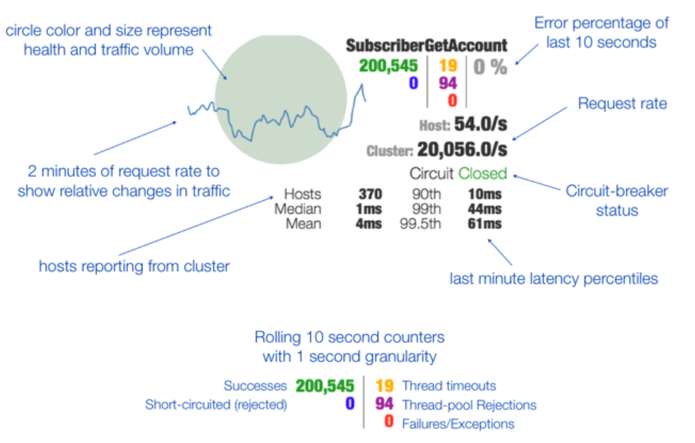
API ML
Difficult to one over another - customers want HA and Security
Milestone | Description
Support for high availability / sysplex distributor in API Mediation Layer #705 | API ML Squad: Complete Caching API and validate HA
AT-TLS aware Zowe API ML #845 | Integrate with the z/OS native AT-TLS component to better fulfill TLS security requirements coming from users.
Metrics Dashboard for ML Services #820 | Allow Tyler, the API ML administrator, to track the security, health and performance of the API ML. Minimum Viable Product for 21PI1: An initial Metrics Service to include basic monitoring information, relying heavily on pre-configuration given by Netflix Hystrix and Turbine.
https://github.com/Netflix-Skunkworks/hystrix-dashboard/wiki

Slide 16
CLI
Embeddable SDK with APIs for secure access in products or containers seems to resonate with consumers
Milestone | Description
Shift order of precedence from command handlers to core SDK (zowe/zowe-cli #895) | Currently, all client applications built on the Zowe SDK must implement logic to handle order of precedence. We want this order of precedence to be standard across client applications. To simplify the development effort for those building apps on the SDK and ensure a standard order of precedence is being followed, we should shift the order of precedence from our command handlers to our core SDK.
Automatic Zowe CLI & SDK Configuration for API ML users | Leverage the API Mediation Layer enhancement described in zowe/api-layer #873 to enhance the `zowe config init` command to automatically set up all configuration information to access all available services registered to the API ML.
Upgrade Migration Utility (zowe/zowe-cli #896) | CLI command to help users adopt best practices of next major release. Profile/configuration migration assistance.
Address Community Issues | Top Enhancement Requests (Most Thumbs up or Hearted): 9 issues under considerations
Zowe CLI: "CERTIFY" to work with CodeReady Workspaces | Run simple tests to validate Zowe CLI Leverage IBM and Redhat resources to achieve this certification. Dependent on having a CodeReady Workspace environment.
Still Researching – no free test environment found yet

Slide 17
Systems (Part 1)
HA on z/OS higher priority than container since container adoption will take some time to happen
Milestone | Description | Deliverables
High Availability | Enable HA with Zowe deployed in Sysplex | Provide YAML format configuration in addition to existing environment variables defined in instance.env https://github.com/zowe/zowe-install-packaging/issues/1793 Separate internal/external communication and provide option to use different certificates https://github.com/zowe/zowe-install-packaging/issues/1762 Integrate Zowe Launcher into Zowe start script https://github.com/zowe/zowe-install-packaging/issues/1716 Change Zowe configuration flow to automatically configure ARM policy for Zowe Launcher https://github.com/zowe/zowe-install-packaging/issues/1694
High Availability | Verify Zowe High Availability Solution | Create basic test cases https://github.com/zowe/zowe-install-packaging/issues/1476 -- stretch goal, rely on open infrastructure
High Availability | Document how to deploy Zowe with HA enablement | Verify and document z/OSMF HA https://github.com/zowe/zowe-install-packaging/issues/1863 Document how to configure Sysplex to work with Zowe HA https://github.com/zowe/zowe-install-packaging/issues/1864

Slide 18
Systems (Part 2)
Performance is important but HA is relatively more important (and assuming container strategy gets traction with customers)
Milestone | Description | Deliverables
Performance Test | Finish implementation and setup component level test suites, provide continuous performance test report. | Create dedicated performance test suite for APIML https://github.com/zowe/zowe-install-packaging/issues/645 Create dedicated performance test suite for Desktop https://github.com/zowe/zowe-install-packaging/issues/643 Create performance test suite to compare API performance with different methods https://github.com/zowe/zowe-install-packaging/issues/633
Performance Test | Improve performance test tool set | Investigate methodology to measure performance of application/zowe startup time https://github.com/zowe/zowe-install-packaging/issues/1587 -- stretch goal Provide options for test cases to store more context and save in test report https://github.com/zowe/zowe-dependency-scan-pipeline/issues/36 Provide option to define how many requests sent to the server instead of test duration https://github.com/zowe/zowe-dependency-scan-pipeline/issues/34 Create Zowe Performance Plugin or client side GUI tool https://github.com/zowe/zowe-install-packaging/issues/636 -- stretch goal
CI/CD | Investigate Jenkins alternatives | Investigate various CI/CD tools vs current Jenkins https://github.com/zowe/zowe-install-packaging/issues/1868

Slide 19
Web UI (Part 1)
Milestone | Description | Deliverables
Session Expiration Customization | Vendor request: per-group customization of zss cookie expiration for using longer-lived sessions of the desktop https://github.com/zowe/zlux/issues/434 | ZSS Enhancement and documentation
HA/FT State Migration | Enhance app-server and zss to push existing state to caching service https://github.com/zowe/zlux/issues/542 - EPIC Zowe Install Packaging - EPIC https://github.com/zowe/zowe-install-packaging/issues/1477 | Seamless transition of state to caching service
HA/FT Launcher | Integrate zowe launcher into z/os zowe builds and enhance it to fit new config and packaging structures so that it can replace scripting responsible for start/stop/restart tasks of components https://github.com/zowe/zlux/issues/542 | New z/os component of zowe
Editor Dataset Write support | Completion of zowe editor enhancement for writing datasets with pessimistic locking (excluding vsam) - Add ZSS API Testing project https://github.com/zowe/zlux/issues/227 - EPIC https://github.com/zowe/zlux/issues/498 - Current Item https://github.com/zowe/zlux/issues/570 https://github.com/zowe/zlux/issues/571 | Saving enabled for datasets in the editor

Slide 20
Web UI (Part 2)
Milestone | Description | Deliverables
Backlog: Continued Platform improvements Continued Explorer/Editor Unification | item 4, 5, 6 & 8 (see backup) swagger - better api catalog support app 2 app documentation & adopt some v2 feature zlux editor backlog jes explorer backlog bug - https://github.com/zowe/zlux/issues/566
Docker/Kubernetes (stretch) | - need cross squad support for testing - especially APIML - need all squads to try out docker tech preview and try extender scenario - Some backlog items from kubernetes sample project https://github.com/zowe/zowe-install-packaging/pull/1725 - server to log to files in addition to stdout https://github.com/zowe/zss/pull/226 - zss tls https://github.com/zowe/zlux/issues/575 - different hostname support for various apiml services https://github.com/zowe/zowe-container-sample/issues/11 - helm chart for zlux app server https://github.com/zowe/zowe-container-sample/issues/2 - helm char for explorers

Slide 21
On Boarding
Milestone | Description | Deliverables
Community Feedback | Conduct (comprehensive) Semi-Annual Zowe Survey, collect and publish results | Survey Monkey Survey Survey Results Analysis Document
Conformance | CURRENT (LTS) Conformance Staging: Develop a process for staging any new/obsolete conformance criteria for the Vnext LTS release | Implement CURRENT LTS Conformance Criteria Update process (Include target dates and ability for extenders to review changes)
Conformance | Support the Zowe Explorer Conformance Introduction | Modify Conformance: 1. Test Criteria and 2. Applications 3. Webpage / badging
Conformance | Incremental Badge consideration for Vx conformant Apps. Goal is to resolve the incremental Badge debate (propose, debate, vote) | Published document describing "incremental badging" OR publish document describing NO incremental badge
Onboarding Experience | Complete Phase 1 tasks to: Better direct Onboarders to appropriate areas within the Zowe Community to ensure their first experience with Zowe is beneficial to them and effective in making them a part of the Community | Publish: Webpage changes, initial/updated Videos and.... Secure a writer and Publish: Blog: "My experience as a new community member"

Slide 22
On Boarding
Milestone | Description | Deliverables
Community Growth | Outreach plan to encourage ISV participation in the Zowe community | Blog: Why extend Zowe? Benefits of OMP Membership
Zowe Stats | Finalize real-time statistics gathering, "Open Source" the app and make it available on Zowe.org (for interactive use) and for Vendor use | Anyone has the ability to generate stats (Zowe.org) Gathering Stats are interactive and online Existing (manual) stat process is automated or deprecated Evaluate (survey the squads?) the need for single/static, monthly stats report available for all and determine which squad should own producing it and filing it
Community Feedback | Introduce retrospectives: Offer a "forum" for anyone who has interacted with Zowe (people, process, technology) as a means to gather feedback from customers and community members. Customers have indicated some of their questions/issues have not been addressed at all, or have not been addressed in a timely manner | Draft a proposal for retrospectives Trial-run the proposal (stretch goal)

Slide 23
Doc Squad
Description/Objectives
High-level doc enhancement: Refactor Zowe docs for better navigation and user experience. #1529: Reorganize TOC (separate install content VS usage content, better group topics) #1446: Separate release notes document into multiple release-specific files
High-level doc enhancement: More on-boarding content to help people get started more efficiently. #1338: Zowe squad member chapter for Zowe docs #1319: Create a key concepts chapter #1276: More details on how to contribute to docs #1179: Create a chapter for contributing for delivering code Complete any content related to zowe.org redesign (continuation from last PI)
High-level doc enhancement: Improve the docs infrastructure #1522: Deliver previews of Docs Site branches #730: Enhancement - Add Slack button, other UI improvements Improve the doc search for better discovery
Continue to support content delivery for Zowe releases and improve existing content. HA See other component-specific work items below. (Add planned work items and include the issue number if any)

Slide 24
TSC
Milestone | Description | Deliverables | Target Date
On-time releases | Improve efficiency/reliability/consistency of Zowe releases. https://github.com/zowe/community/issues/915 | Action plan for improvements in the release process | March
Major releases | Improve the major release documentation | Visible document outlining when and how we start formal discussions around the new major release. Version? | April
Zowe Governance | Complete TSC charter amendments https://github.com/zowe/community/issues/923 https://github.com/zowe/community/issues/922 | GOVERNANCE document CONTRIBUTING document | February

Slide 25
ZLC Focus for upcoming PI

Slide 26
ZLC Focus for PI
Zowe Support Offering Conformance
What is Zowe core and how can someone claim support for it ?
How do OMP managed Zowe extensions (CLI, APIML) fit in
Drive outreach to gather more usage data/trends
Work with Systems Team on future infrastructure needs?

Slide 27
Thank You

Slide 28
Backup with additional detail

Slide 29
Web UI (Stretch)
 | Priority | Milestone | Description
1 | High | Kubernetes Containerization https://github.com/zowe/zlux/issues/575 https://github.com/zowe/zowe-container-sample/issues/11 https://github.com/zowe/zowe-container-sample/issues/2 | Using https://github.com/zowe/zowe-container-sample ... make another container option for zowe which has each server in its own container
2 | High | TLS server support for ZSS https://github.com/zowe/zss/pull/226 https://github.com/zowe/zowe-common-c/pull/178 - merged | Finalize TLS support for zss by automating the assignment of keys and certs from the zowe keystore to use with zss
3 | High | Add more test cases to pipelines https://github.com/zowe/zlux/issues/571 | editor, sso, ha/ft, zss apis,

Slide 30
Web UI (Stretch)
 | Priority | Milestone | Description
4 | medium - api catalog swagger support | API Catalog Swagger support https://github.com/zowe/zlux/issues/422 | Swagger for ZSS & Zowe Application Server - ZSS register directly with APIML, but don't host its own swagger docs - Zowe Application server display few swagger endpoints, but none in api catalog
5 | medium - zlux editor | Continued ZLUX Editor Improvements https://github.com/zowe/zlux/issues/574 - improved icons https://github.com/zowe/zlux/issues/537 - hover help
6 | medium - explorer-jes | Explorer JES - Global hotkeys - App 2 App with zlux editor https://github.com/zowe/zlux/issues/490 - Standardize logs - Use configuration Dataservice to persist settings https://github.com/zowe/zlux/issues/487 - Allow `SAVE AS` for JES explorer files https://github.com/zowe/zlux/issues/303 - JES Explorer: Number of Jobs https://github.com/zowe/zlux/issues/565
8 | medium - Core Feature Enhancement/Documentation | Updating sample apps to give example of app2app version 2 - Add some example and areas to explorer as well https://github.com/zowe/zlux/issues/555#issuecomment-747112457 https://github.com/zowe/zlux/issues/581

